Slide 1


University of Sydney
Hardware implementation of series and parallel adapter modules with online training capable of multi-domain learning
Presented by Niyana Yohannes
Notes:
Good Morning proffesors and students. My name is Niyana Yohannes and today I'll be presenting my Final Year Thesis to you all. The title of the thesis is:
Hardware implementation of series and parallel adapter module with online training capable of multi-domain learning

Slide 2
Intro & Motivation

Slide 3
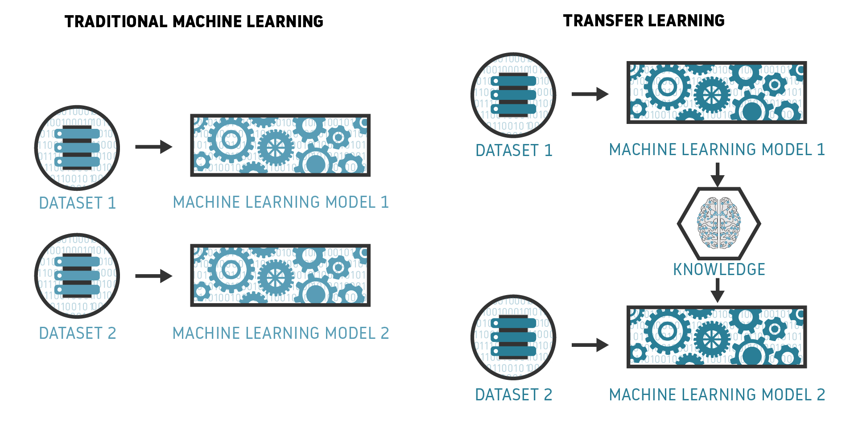
Notes:
Historically, machine learning algorithms were primarily designed to address single, isolated tasks
And research in this field concentrated on enhancing these algorithms to optimize accuracy for those specific tasks.
However, as of late, there has been a shift in focus towards the development of machine learning algorithms that can effectively handle multiple problems with a single model.
Transfer learning offers a solution to this recent challenge. In simple terms, transfer learning, is the reuse of a pre-trained model on a new problem
Considering deep neural networks, fine-tuning stands out as a prominent and widely-used transfer learning technique. But, despite being very effective, fine-tuning require retraining or modifying of all the original networks’ parameters for each new task which is computationally heavy.

Slide 4
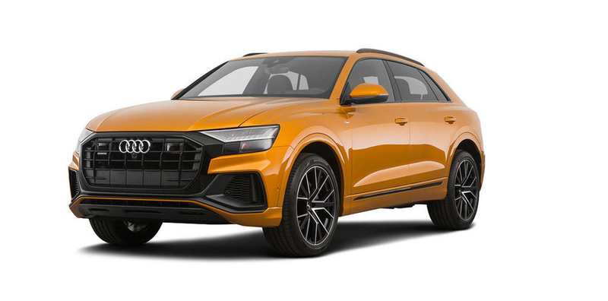



Multiple-domain Learning
Visual Domains
Animal Images
Traffic Sign Images
Vehicle Images
Aircraft Images
Notes:
A new method of transfer learning, called multiple-domain learning aims to develop models that can compactly represent different domains.
In the image we see examples of different visual domains

Slide 5



Adapter Modules
A lightweight and efficient way to adapt pre-trained networks to new domains without requiring extensive retraining or modifying of the original models’ parameters.
Act as small learnable modules
Inserted between the layers of a pre-trained network, allowing it to learn task-specific information while preserving the majority of the original model’s knowledge
Notes:
Adapter modules present a way to perform multiple-domain learning.
Adapters are modules that are used to provide a lightweight and efficient way to adapt pre-trained networks to new domains without requiring extensive retraining or modifying of the original models’ parameters.
They act as small learnable modules that are inserted between the layers of a pre-trained network, allowing it to learn task-specific information while preserving the majority of the original model’s knowledge.
In this project, we aim to explore adapter modules integrated into hardware with online training.
This is motivated by considering a scenario in which an hardware device with a classification model has been trained for a specific domain, enabling it to perform classification tasks. For example, identifying a particular animal.
Now, imagine the hardware device needs to expand its capabilities to detect a new domain. For example, recognizing the same animal but in a different environment or habitat.
An objective is to achieve this without requiring offline training and without requiring full fine-tuning.
By incorporating a hardware based adapter module with online training into the device, we can easily extend the device's capabilities to classify the new domain without the need to perform offline training or full fine-tuning.

Slide 6
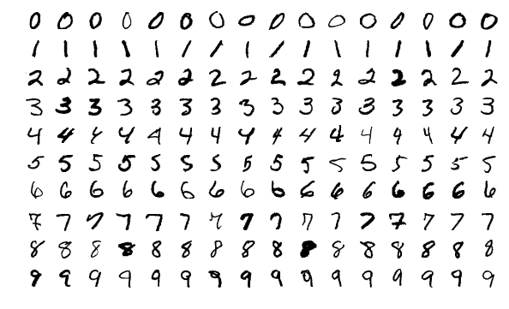
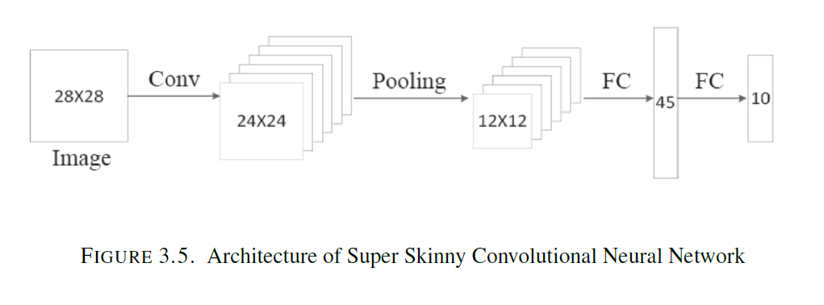
Hardware-based adapter module with online training capable of performing multi-domain learning
SSCNN Network to be adapter
MNIST and Reduced MNIST
Notes:
So with that as motivation, this project introduces a hardware-based adapter module with online training capable of performing multi-domain learning implemented on an FPGA board.
the Zynq UltraScale+ RFSoC ZCU111 FPGA Evaluation board
Specifically, a series and parallel configuration are designed to adapt a convolutional neural network called the Super Skinny Convolutional Neural Network (SSCNN) composed of one convolutional layer, 1 max-pooling layer and 1 fully connected layer.
The different domains used for evaluation of the adapter network is the original MNIST dataset which is one domain, and a new reduced MNIST dataset which has the number 9 removed as another domain.

Slide 7
Unique Contributions

Slide 8
Explore an adapter architecture implemented entirely in hardware, encompassing both the inference and training stages
Delve into adapter architectures tailored for smaller networks and datasets.
Notes:
Looking at FPGA implentation of Neural Networks in literature, the main hardware implementations often involve feed-forward neural networks where the network’s training occurs in an offline computing environment. This means the training phase is executed in software, while the hardware is employed for inference.
Training conducted entirely in hardware is relatively rare and infrequently pursued.
After researching various existing adapter architectures, all of the approaches relied entirely on software methods, where both inference and training, are performed online.
So considering the advantages of FPGAs, there is a compelling interest in investigating adapter architectures in a hardware context where both inference and training are executed in hardware.
Thus, the primary contribution of this thesis is: SCREEEEEEEN
Also, during research of existing adapter architectures, most were designed for extremely large networks such as deep CNNs and ResNets and also extremely large datasets such as ImageNet.
The application and performance of adapter architectures for smaller networks and datasets remain largely uncharted territory.
So, the second significant contribution of this thesis is to:
SCREEEN

Slide 9
Methodology

Slide 10
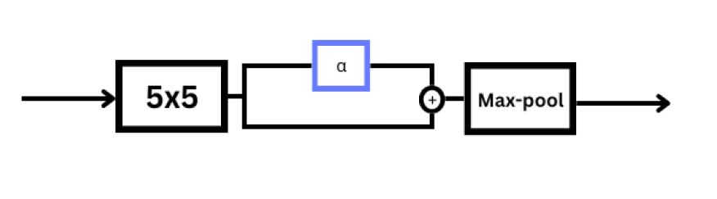
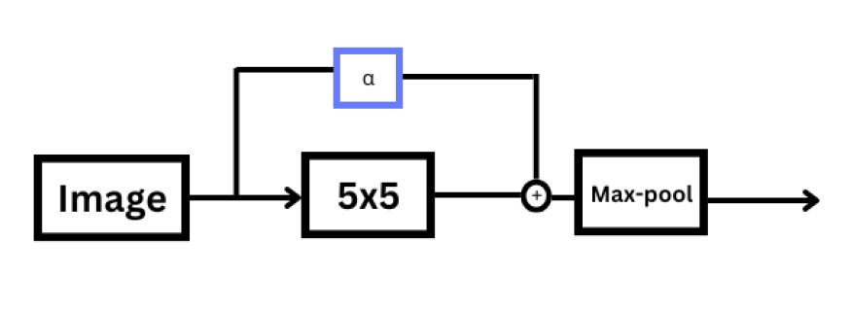
Adapter Modules Architecture
1x1 Filter Bank
Series Adapter
Convolutional Layer
Pooling Layer
1x1 Filter Bank
Parallel Adapter
Input
Convolutional Layer
Pooling Layer
Notes:
For the development of the adapter architecture, the series and parallel residual adapter architectures found in literature was used as the foundational framework for this projects adapter module architecture.
The fundamental idea of introducing 1x1 filter banks or kernels into the convolutional layer is used in this projects adapter architecture just like in the literature
As the images show, the series adapter is placed in series with the convolutional layer of the SSCNN network while the parallel adapter is placed in parallel with the convolutional layer of the SSCNN network

Slide 11
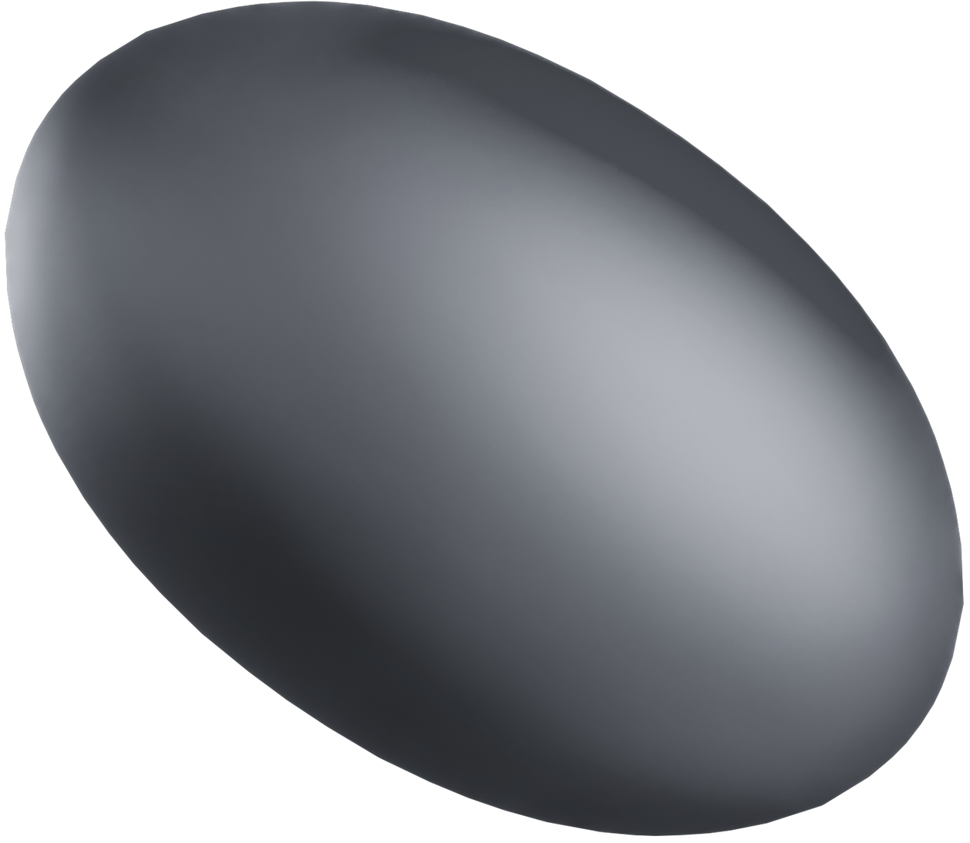
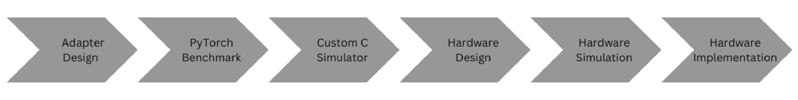
Workflow followed throughout project
Notes:
The project is divided into two main components: software and hardware.
In the software design phase, the adapter network is designed in software and tested using the two MNIST datasets. It is initially developed and evaluated in PyTorch which serves as a benchmark.
Then, a custom C network is designed, which manual coding of the adapter network, such as the inference and backpropagation algorithms, and evaluation with the two MNIST datasets is again performed.
For the software, 32-bit single precision floating point was used.
On the hardware side, a high-level circuit design of the adapter module is created using SystemVerilog, which is then converted into an RTL design.
Unlike the software aspect, where the design invloves both the adapter and network integration, the hardware design focuses solely on the adapter module.
Correctness is verified by generating inputs for the adapter module in software and providing them to the network. The adapter module is then simulated using Vivado Simulator, and its output is compared with the C simulator’s output.
Once correctness is validated, the adapter modules are synthesised and inmplented onto the target board using Xilix Vivado, and resource utilization, power consumption, and latency assessment of the adapter module is carried out
In hardware, we also utilize 32-bit single precision floating point as the numbering system. But we also design the adapter modules with 16-bit half precision floating point, and custom 12-bit and 10-bit precision floating point.

Slide 12
Results

Slide 13
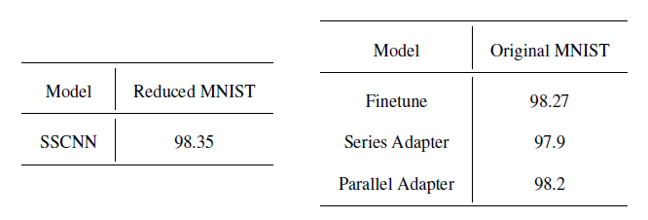
Software Results: PyTorch Network
Notes:
The tables summarize the PyTorch simulation results for the SSCNN adapter network.
The first table shows the accuracy score for the original unadapted SSCNN network trained on the Reduced MNIST dataset, achieving a base performance of 98.35% accuracy.
The network was then fine-tuned, with both full vanilla finetuning and fine-tuning with the series and parallel adapters on a new dataset, the Original MNIST dataset.
Full vanilla finetuning achieved a slightly higher accuracy of 98.27%, but it required the retraining of the entire network’s parameters.
On the other hand, the series and parallel adapters only introduced a small number of additional parameters for training and produced similar levels of accuracy.

Slide 14
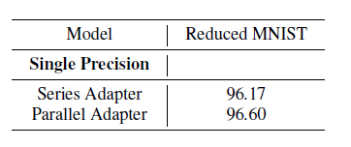
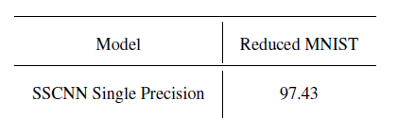
Software Results: Custom C Network
Notes:
The same tests were conducted as the PyTorch for the Custom C network and we get similar results. This means the inference and backpropogation algorithm implemented manually was correct.

Slide 15
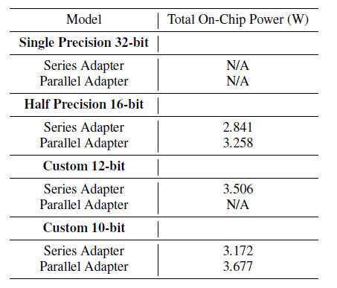
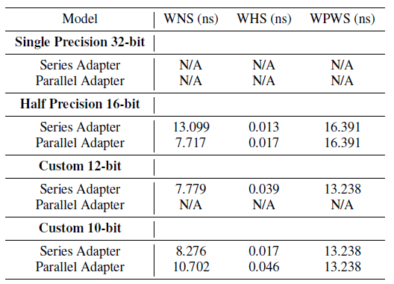
Hardware Results
Notes:
Moving onto hardware results, the adapter modules were designed and implemented in hardware.
As mentioned, four different floating point bit-widths were designed and resource usage examined. A floating point IP core was used to perform the computation.
The images on the screen show the The total on-chip power and timing information of the designs can also be seen.

Slide 16
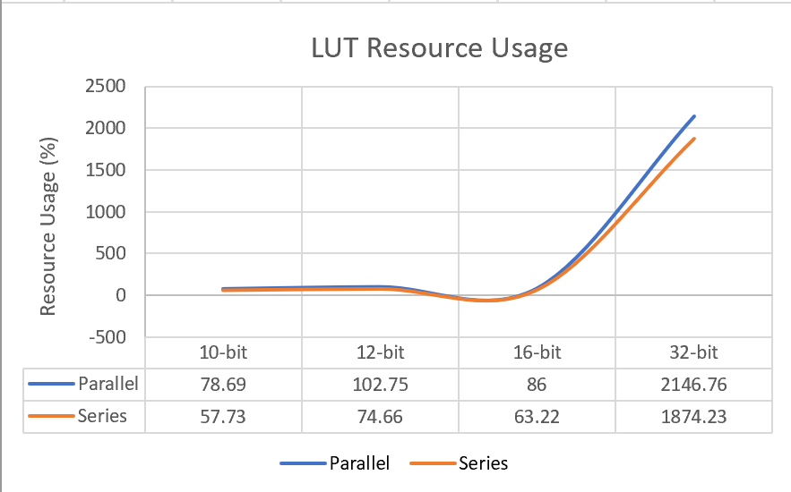
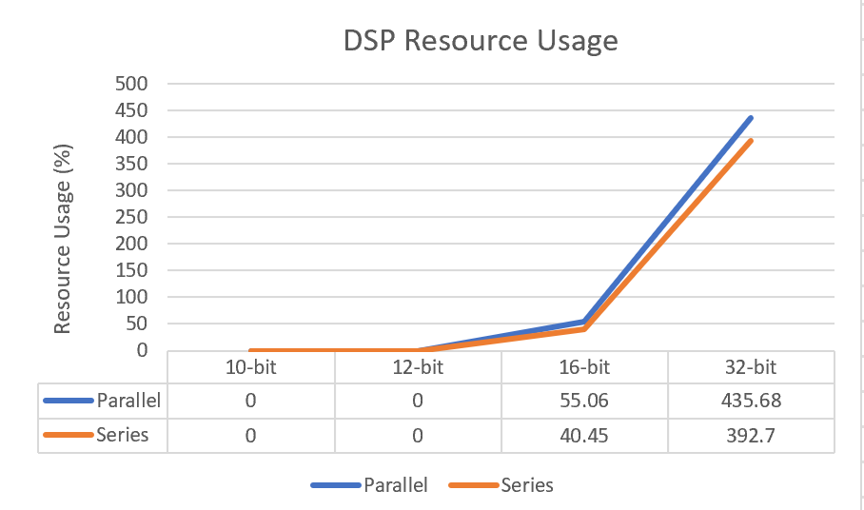
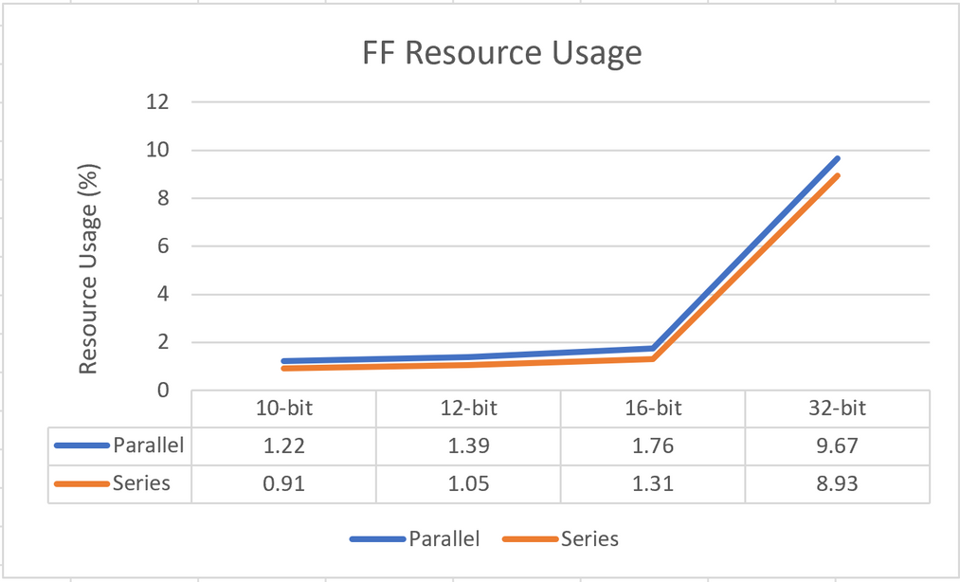
Hardware Results
Notes:
This slide shows LUT, FF and DSP usage of the different designs.
The 32-bit width single precision series and parallel designs utilized the most resources on the target board and were too large to fit on the board. The 12-bit parallel adapter design was also too large to fit on the target board.
The 16-bit half precision series and parallel designs, the custom 12-bit precision serial design, and the custom 10-bit precision series and parallel designs all fit on the board and the resource usage decreased as the bit width decreased.
The series adapter designs consistently required less hardware usage then the parallel adapter designs, making it a more viable option in hardware, despite the parallel adapter performing slightly better in software.

Slide 17

01
Project highlights the feasibility of utilizing adapter modules in hardware
Current resource demand of the adapter modules exceeds or use a large portion of the available hardware resources
02
Project
conclusions
03
Experiments have also demonstrated promising avenues for optimizing and reducing hardware usage
Notes:
The experiments conducted have highlighted first and foremost the feasibility of utilizing adapter modules in hardware to perform multi-domain learning and effectively adapt networks for different data- sets. It serves as a proof-of-concept for adapter modules in hardware.
However, it also has revealed that the current resource demand of the adapter modules exceeds or use a large portion of the available hardware resources.
Despite that, through the experiments performed, this project has also demonstrated promising avenues for optimizing and reducing hardware usage.
One of the notable strategies for resource reduction is the reduction of the bit-width format, while still ensuring that the adapter modules can effectively support online training.
Also, exploring different adapter module architectures may also lead to reductions in hardware utilization
Looking ahead, a primary objective for future work should be the optimization of adapter modules to minimize hardware resource usage and power consumption.

Slide 18
Thank you
Notes:
That concludes my presentation. Thank you all for listening!

